Slide 1
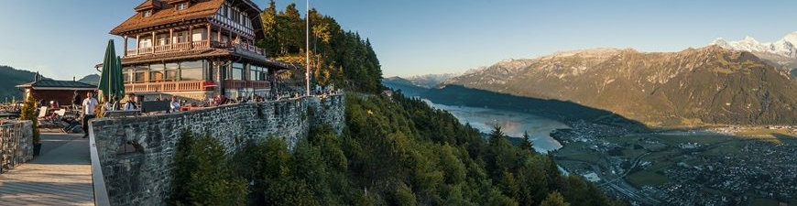
Switzerland’s secrets
Where is what to expect?

Slide 2
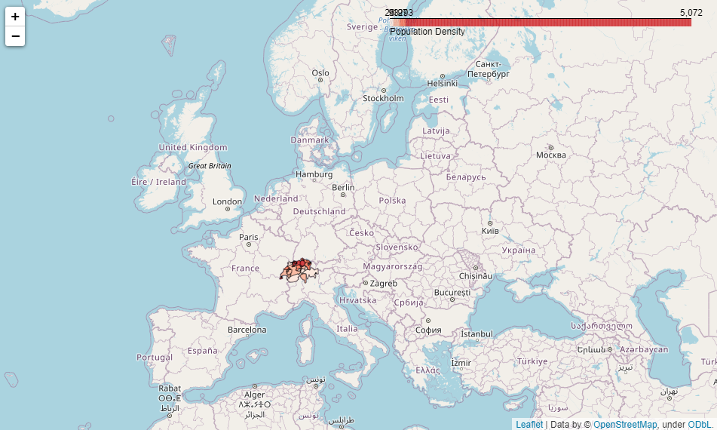
Where is Switzerland?
Central Europe
Famous for watches, chocolate and as tax haven
Switzerland

Slide 3
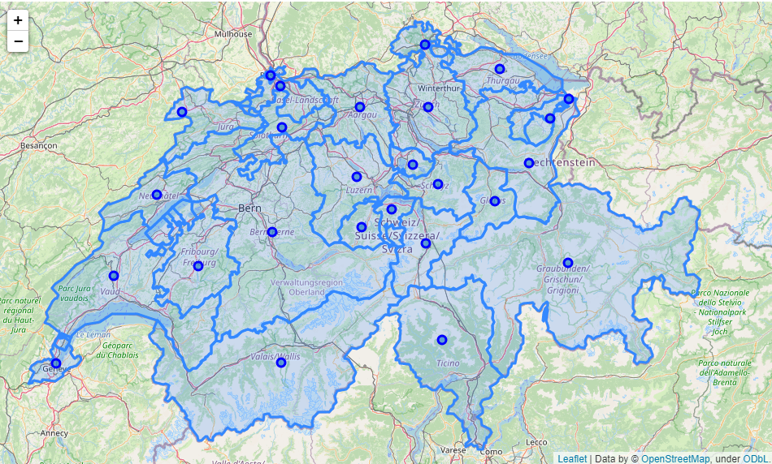
Switzerland’s inner structure
Switzerland is subdivided into 26 areas, or cantons.
Typical for European countries, the borders of country and cantons were formed and shaped over the centuries in wars and treaties.

Slide 4
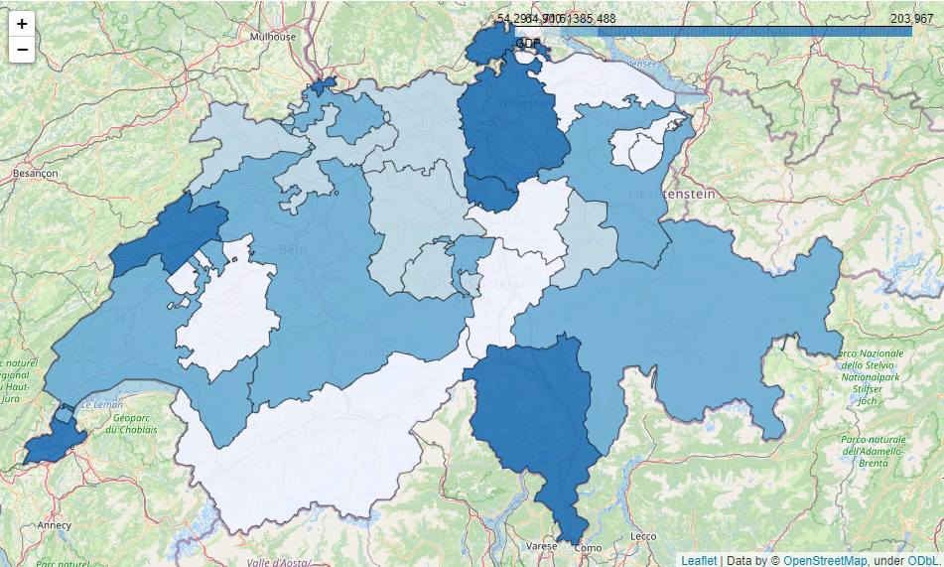
Switzerland’s cantonal GDP
7 cantons with high GDP:
Basel
Geneva
Neuchâtel
Ticino
Schaffhausen
Zug
Zurich

Slide 5
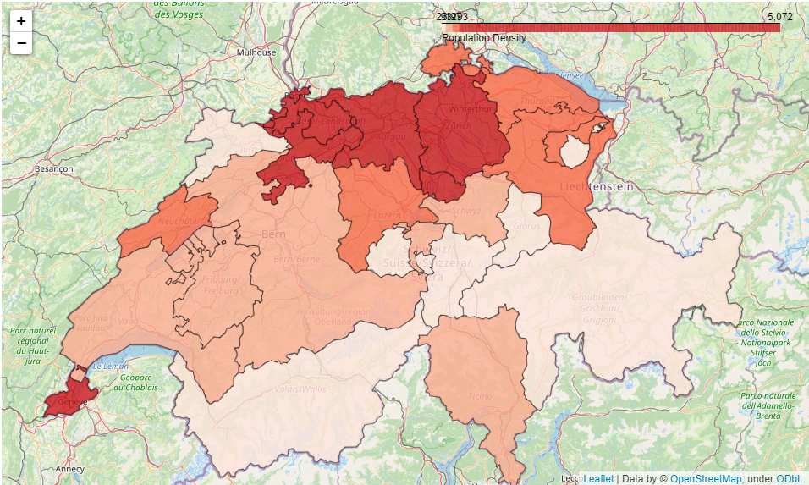
Switzerland’s population density
2 areas with high population density:
Central north
Geneva

Slide 6
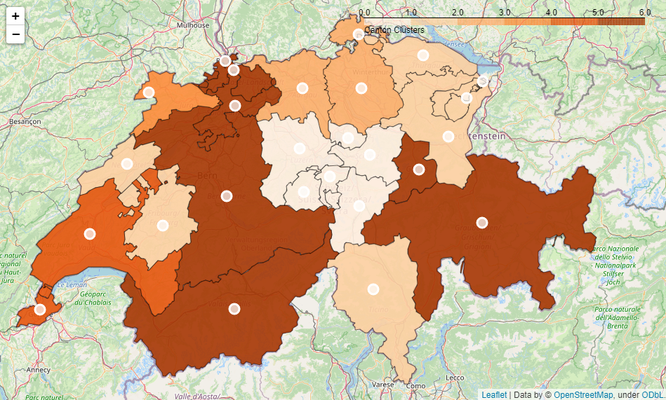
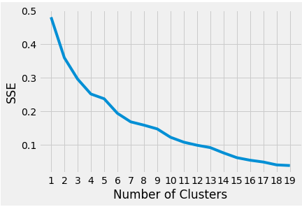
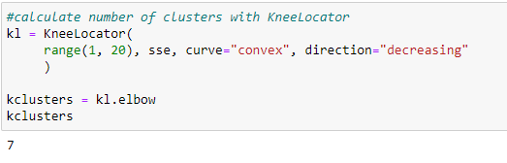
Canton’s clusters
Kmeans clustering based on Top 10 venues (Foursquare)
7 clusters
2
1
5
5
2
1
3
2
5
1
0
0
1
1
0
0
0
0
6
5
1
6
4
1
4
6

Slide 7
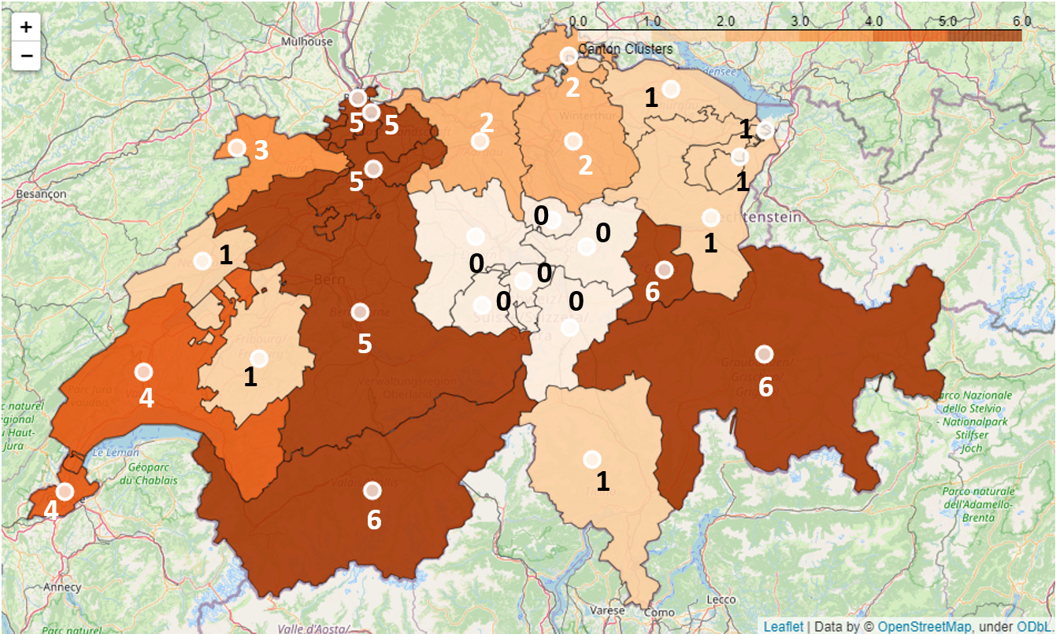
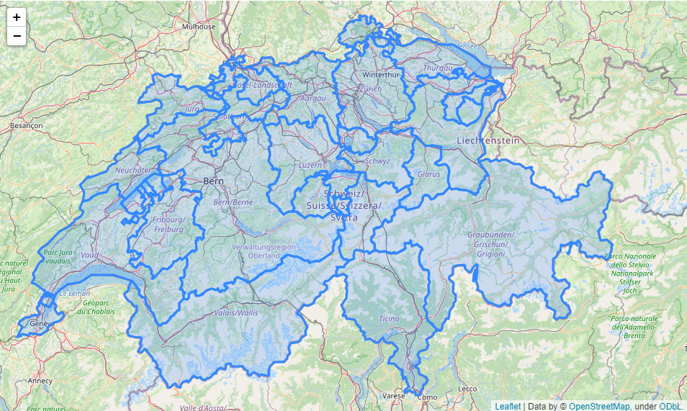
Where to expect what (map)
Clusters
Winter sports & mountains
Population Density
GDP
Decelerated recreation & nature
Sights & scenery
Live & Work

Slide 8
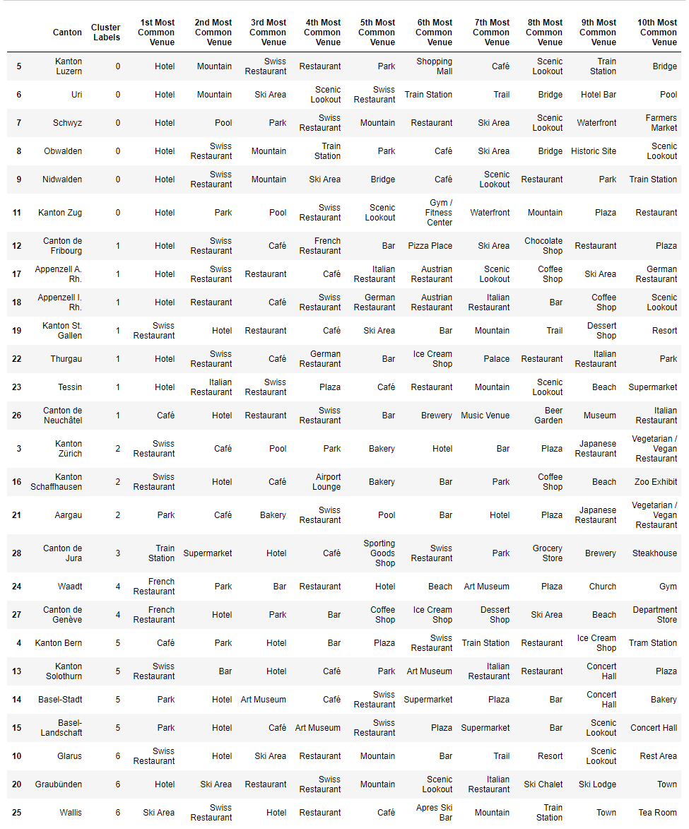
Where to expect what (table)
Sights & scenery
Live & Work
Decelerated recreation & nature
Live & Work
Winter sports & mountains

